Slide 1

The Machine Learning Process
When should I use the "inplace" parameter in pandas?
Dr. Reza Dibaj

Slide 2
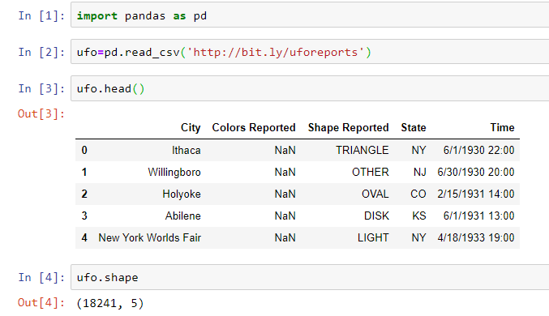
The usage of “inplace” parameter
Let’s pull up an example dataset as follows:
Notes:
import pandas as pd
ufo=pd.read_csv('http://bit.ly/uforeports’)
ufo.head()
ufo.shape

Slide 3
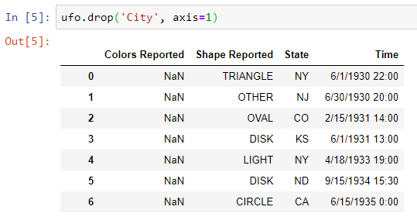
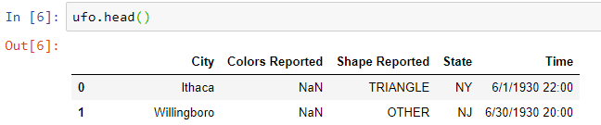
The usage of “inplace” parameter
What if we do not care about the “City” column?
But is it truly deleted from the DF?
Notes:
ufo.drop('City', axis=1)
ufo.head()

Slide 4
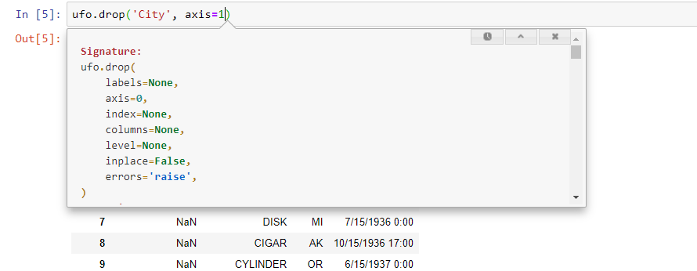
The usage of “inplace” parameter
If we use Shift + Tab we can see some default parameters, including inplae=False.
Notes:
ufo.drop('City', axis=1)
ufo.head()

Slide 5
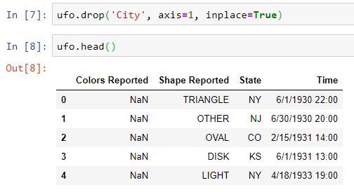
The usage of “inplace” parameter
If we use inplace=True it permanently drop the column as follows. Do you see any difference between the time we run the code with inplace=True and without?
Notes:
ufo.drop('City', axis=1, inplace=True)
ufo.head()

Slide 6

The usage of “inplace” parameter
If something happens permanently or inplace, then there will be no print out.
Notes:
ufo.drop('City', axis=1, inplace=True)
ufo.head()

Slide 7

Group Discussion
Why the default value for inplace is set to False?

Slide 8
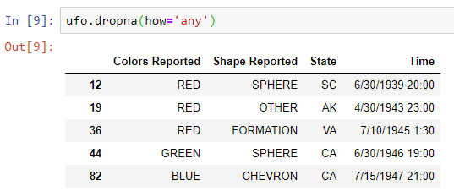
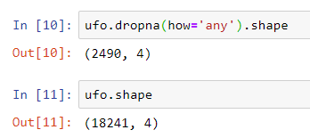
The usage of “inplace” parameter
Let’s drop the rows that contain missing values…
And see the dimension of the result DF as follows:
Notes:
ufo.dropna(how='any')
ufo.dropna(how='any').shape
ufo.shape

Slide 9
Group Discussion
Please check the following methods and see if they have inplace as their optional parameter.
DF.rename()
DF.sort_values()
DF.set_index()

Slide 10


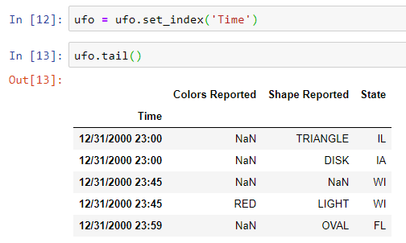
Group Discussion
Both of the following two commands work. Which of the following approach has a higher performance? Why?

Slide 11

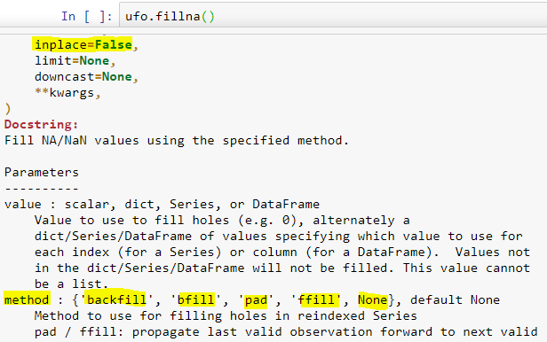
Bonus Tip
How to take advantage of default inplace=False in order to explore pandas methods?
Use Shift + Tabs to open the help sheet.
Notes:
ufo.fillna()

Slide 12
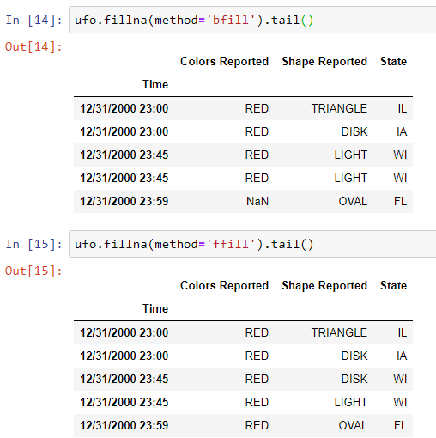
Bonus Tip
Now, we can check the result and decide which one do we want to apply permanently.
Notes:
ufo.fillna(method='bfill').tail()
ufo.fillna(method='ffill').tail()

Slide 13

Thank you
Question?
To be
Not to be

